Slide 1

Marked disparity of micro-RNA modulation by cGMP- selective PDE5 versus PDE9 inhibitors in heart diseases
miRs DAMEV Group
Daniel Bun, Ashmita Mainali ,Manuela Chaves, Esther Jokodola ,Vedika Desai
EEOB 546 Final Project
May 1st, 2024
Notes:
EJ + intro for all

Slide 2
OUTLINE
Background study on micro-RNA’s
Description of workflow
Overview of documentation
Results : comparison with published paper results
Notes:
EJ

Slide 3

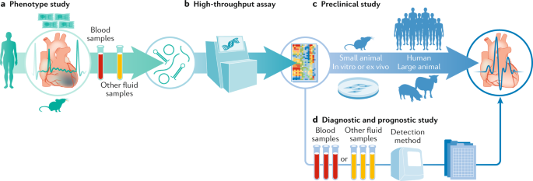
BACKGROUND
MicroRNAs (miRs) are small ribonucleic acids that regulate gene expression by facilitating mRNA degradation, inhibiting protein translation, or degrading polypeptides.
They have been found to be involved in heart disease and used as diagnostic and therapeutic agents.
Notes:
EJ

Slide 4

Methods
C57BL/6J
Cardiac Pressure Overload (PO) (left ventricle surgery) and Sham (fake surgery/negative control) on mice used for drug intervention studies.
Contrast of 2 closely related therapies: Inhibitors of Phosphodiesterase type 5 and type 9 (PDE5-I , PDE9-I) on mice for 6 weeks.
PDE5 regulating nitric oxide while PDE9 regulates natriuretic peptide dependent signaling.
Total RNA was isolated from left ventricular myocardium and analyzed for RNA integrity number(RIN) values and concentrations.
RNA-seq was used to analyze gene expression in a mouse model. Differential expression of genes between different treatments was performed using DESeq2 and KEGG.
Notes:
VD

Slide 5
FINDINGS
miRs profiling could distinguish between two therapeutic interventions, PDE5-I and PDE9-I
Activate PKG by different cGMP pools.
PDE5-I reduces a broad array of miRs associated with the disease state
PDE9-I had no impact

Slide 6




Description of Workflow
Processing
Check for repetitive miRNA and Keep miRNA present in >50 % of the samples
Processing
Map the remaining to Mus musculus miRgeneDB database and keep only those present in mouse.
Analysis
Heat Map & Volcano Plots
Figures
DeSeQ analysis and Limma for differential gene expression
Notes:
EJ

Slide 7
Overview of Documentation
Downloaded the data, inspect and filter the data
Process the data to format them for the analysis we chose to reproduce
Rerun the analysis in R and Python
Visual summaries

Slide 8
DATA PROCESSING
Before beginning the analysis, the miRNAs needed to be filtered such that there were reads for more than 50% of the mice. Afterwards, the remaining miRNAs from that filter was compared against the Mus musculus miRgeneDB database.
Took counts of miRNAs and checked if there are 0 in more than half the mice samples.
Since miRNAs are duplicated depending on 3' or 5' end, miRNAs were split into 3 objects: -3p, -5p, and non-p using list comprehension.
Removed "-3p" and "-5p" using map() + lambda functions.
Then each object is checked against the miRgeneDB database using set() & comparisons.
Added "-3p" and "-5p" to their respective objects and merged all commonalities against the file containing counts using Pandas.
Went from 1900 -> 510 -> 376 final miRNAs remaining.
Notes:
MINE to present - DTB
Base R for 50%.
Filtering done with Snek.

Slide 9
Workflow
DESeq2
Limma
DESeq object (dds) from cold data & countdata
Normalization DESeq(dds)
Differential gene expression results(dds)
Applied FDR correction
Keep padj < 0.05
DEGList()
Model.matrix()
Voom()
Lmfit()
MakeContrasts() + Contrasts.fit()
Bayes analysis
Notes:
AM, DTB can do limma
Limma
Originally developed for microarray

Slide 10
LIMMA + EdgeR Packages
Input: Count Table
Output: DEGs
Workflow
R package
Differential Expression (DE) analysis of microarray data
Advantages:
DEGList()
Model.matrix()
Voom()
Lmfit()
MakeContrasts() + Contrasts.fit()
Bayes analysis
Creates a loop, performing action on every gene of the data set independently.
Allows for flexible model specification, allowing incorporation of almost any kind of metadata
Statistics: Empirical Bayes - estimating the prior distribution – shares information across genes

Slide 11
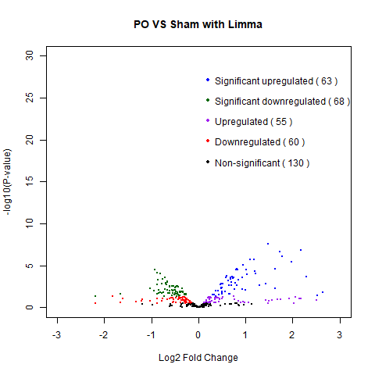
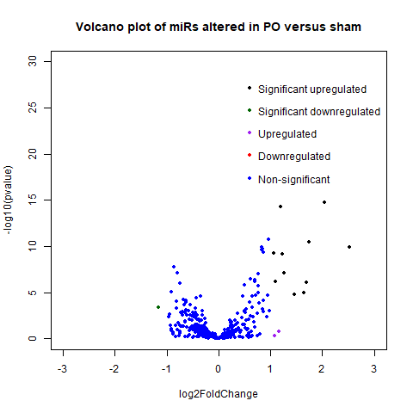
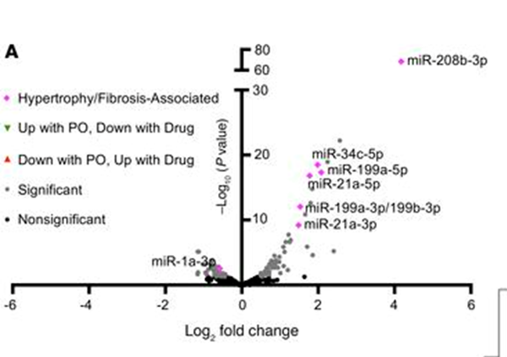
Sham vs. PO
PAPER
LIMMA
DESEQ
Notes:
AM, DTB

Slide 12
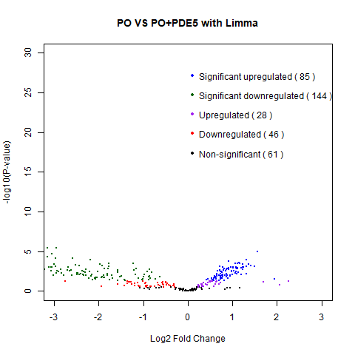
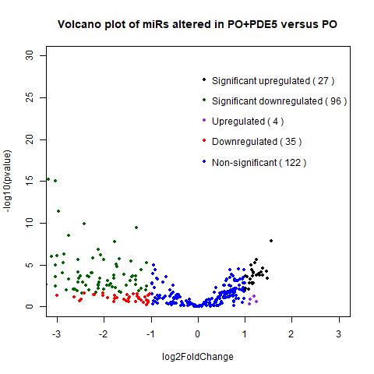
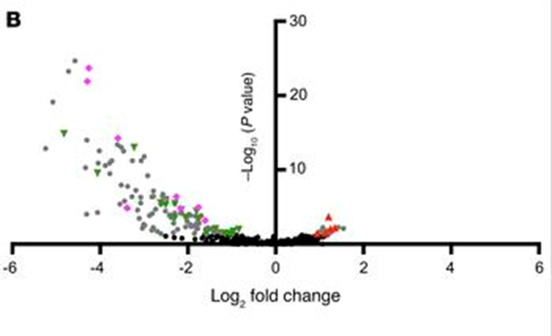
PO+PDE5-I as compared to PO
PAPER
LIMMA
DESEQ
Notes:
AM, DTB
Significant upregulated 27
Significant downregulated 96
Upregulated 4
Downregulated 35
Non-significant 122

Slide 13
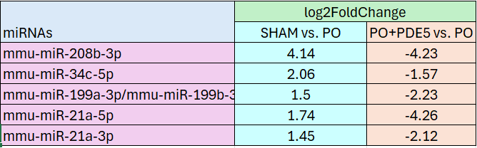
Effects of PDE5 on miRNAs Associated with Hypertrophy
Found similar downregulation of miRNAs associated with hypertrophy by PDE5 induced alone by PO.
Notes:
AM

Slide 14
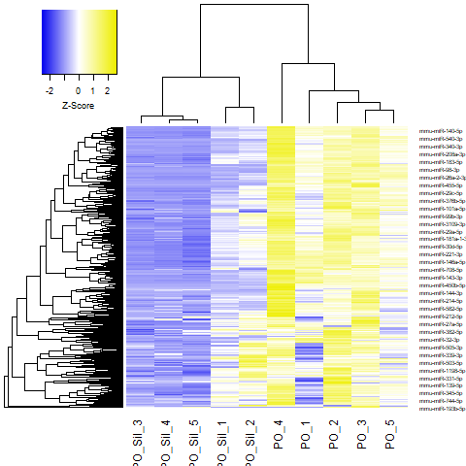
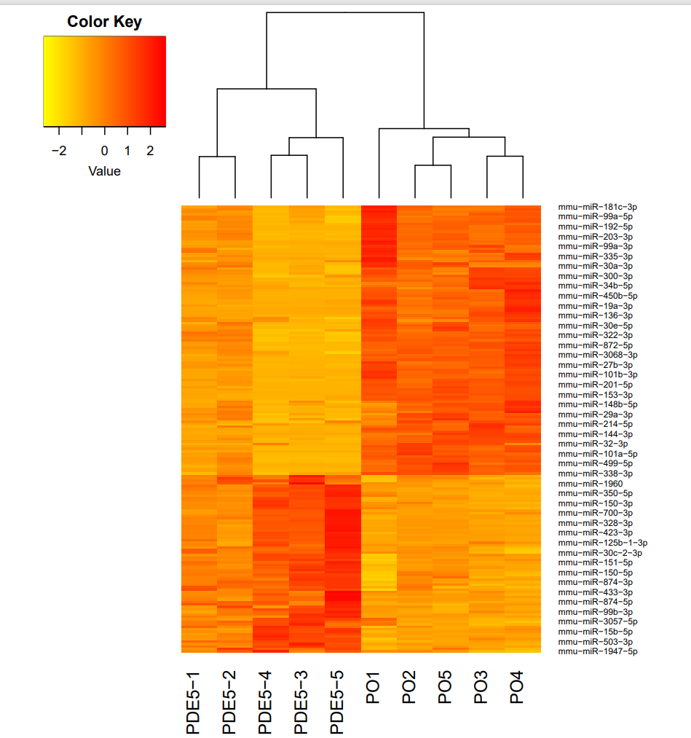
Heatmap of PO+PDE5 vs. PO
LIMMA
DESEQ
Notes:
AM, DTB

Slide 15
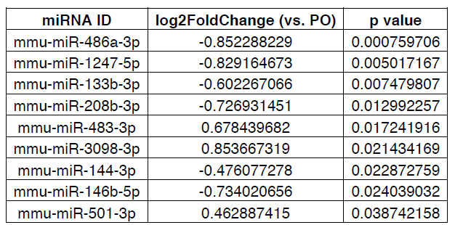
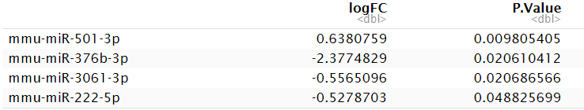
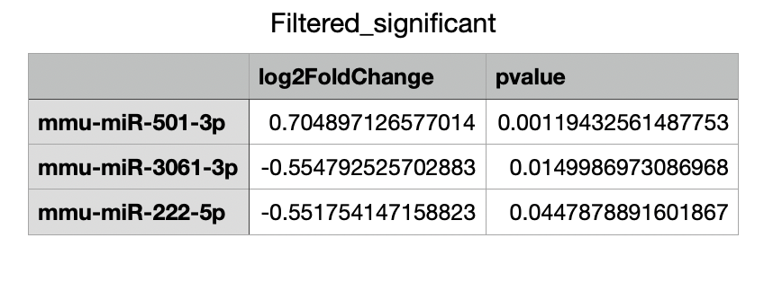
PO+PDE9-I as compared to PO
PAPER
LIMMA
DESEQ
PDE9-I has minimal impact on any miR (P < 0.0001).
No p – adjust method applied to LIMMA or DESEQ
Notes:
MC, VD

Slide 16
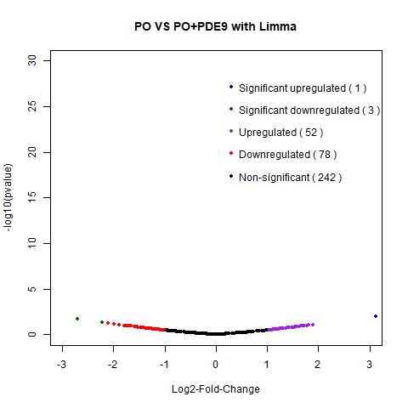
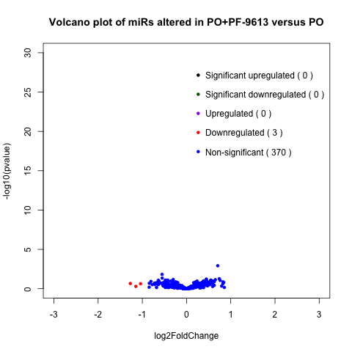
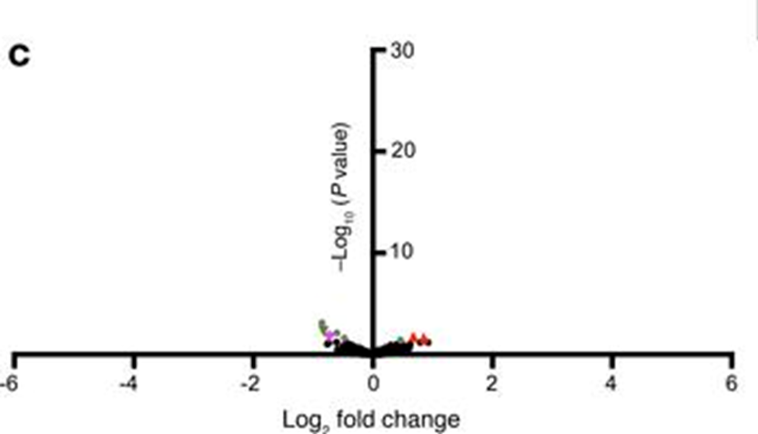
PO+PDE9-I as compared to PO
PAPER
LIMMA
DESEQ
PDE9-I has minimal impact on any miR (P < 0.0001).
No p – adjust method applied to LIMMA or DESEQ
Notes:
MC, VD
Significant upregulated 1
Significant downregulated 3
Upregulated 52
Downregulated 78
Non-significant 242
Significant upregulated 0
Significant downregulated 0
Upregulated 0
Downregulated 3
Non-significant 370

Slide 17
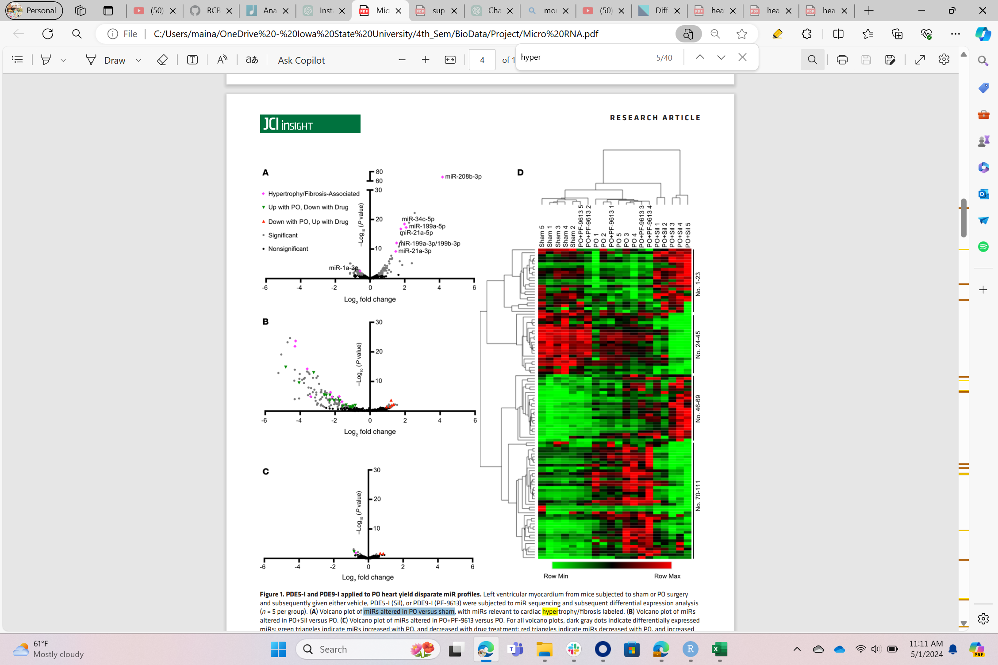
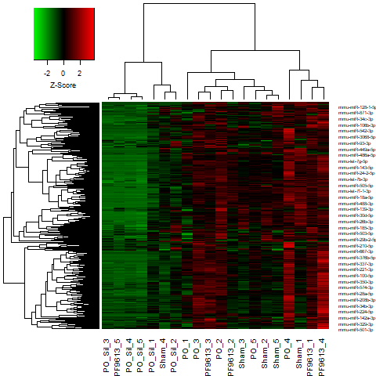
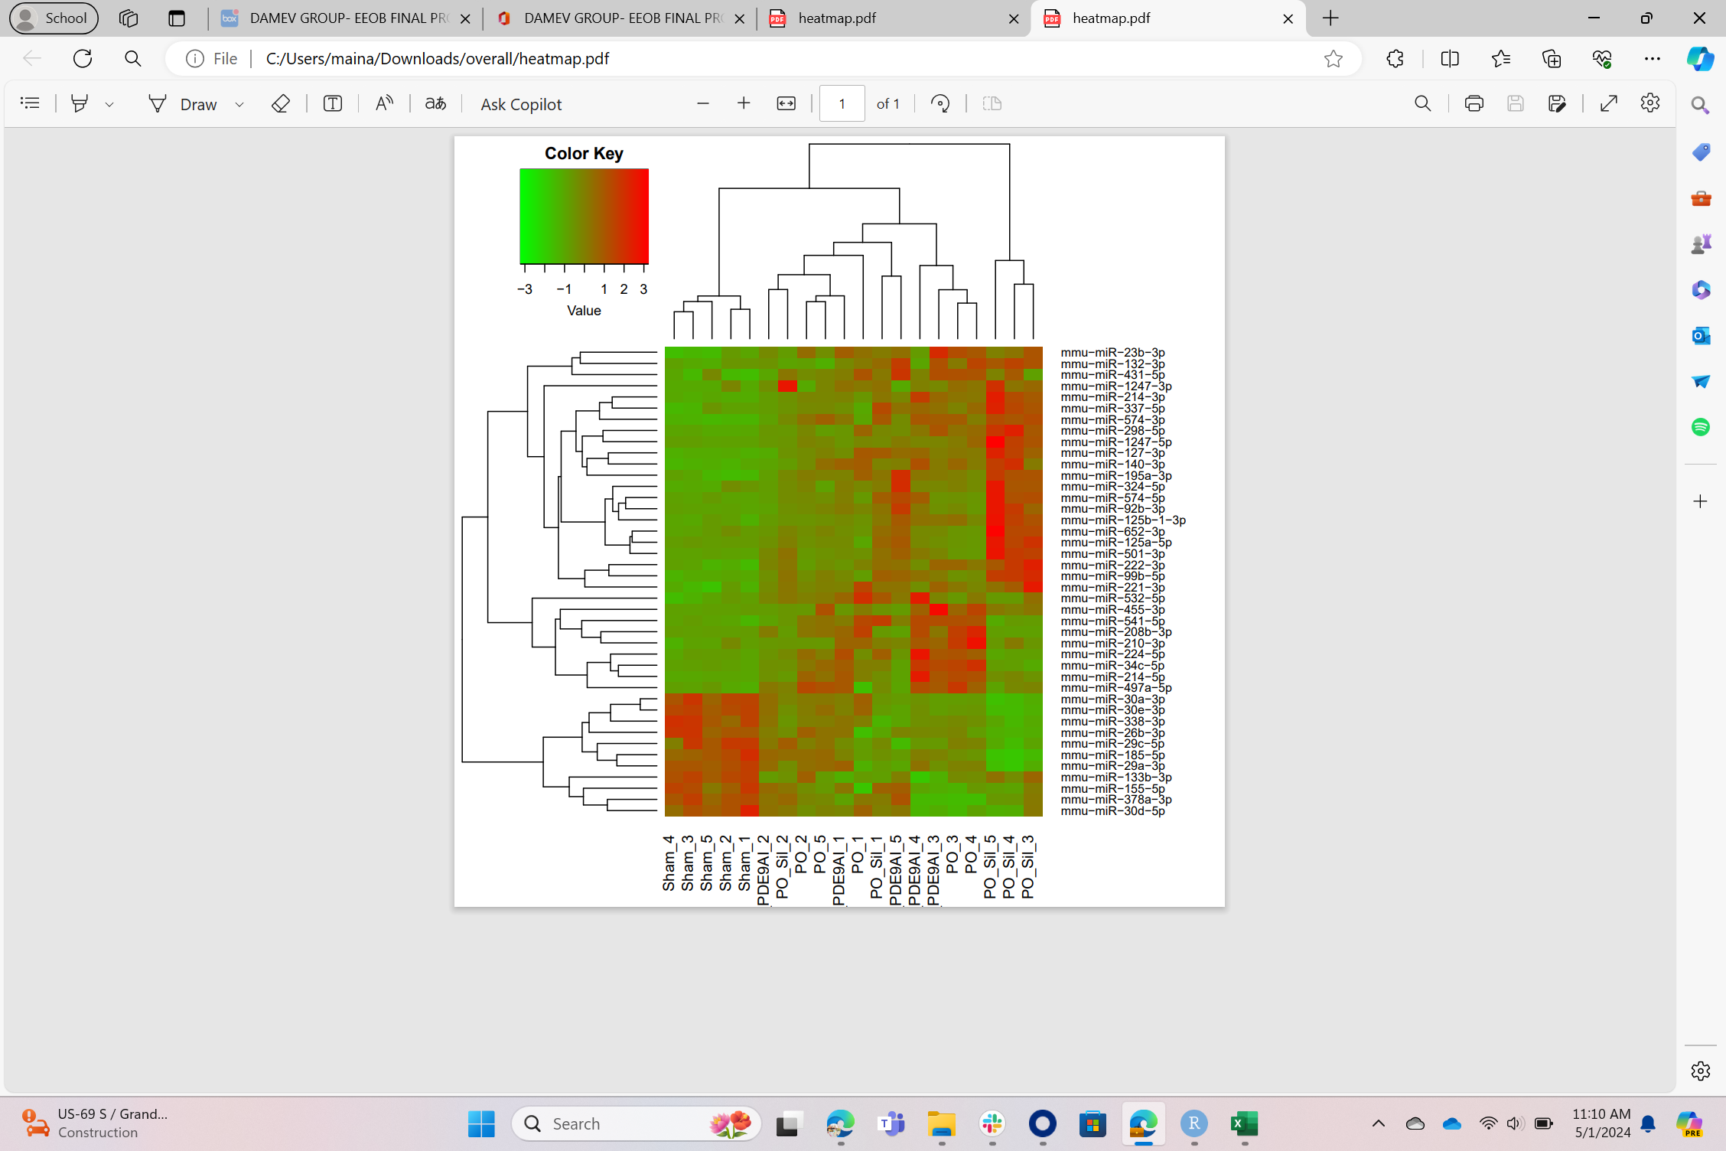
Heatmap of Sham, PO+PDE5, PO+PDE9 vs. PO
PAPER
LIMMA
DESEQ
Notes:
AM, DTB

Slide 18
Summary of findings
Treatment | Paper | Limma | DESeq
SHAM VS PO | Significant upregulated 63 Downregulated 48 | Significant upregulated 63 Significant Downregulated 68 Upregulated 55 Downregulated 60 Non significant 130
PO VS PDE5-I | Reduced miR expression broadly | Significant upregulated 85 Significant downregulated 144 Upregulated 28 Downregulated 46 Non-significant 61 | Significant upregulated 27 Significant downregulated 96 Upregulated 4 Downregulated 35 Non-significant 122
PO VS PDE9-I | Minimally altered miRs associated with PO, impacting only 9 moderately | Significant upregulated 1 Significant downregulated 3 Upregulated 52 Downregulated 78 Non-significant 242 | Significant upregulated 0 Significant downregulated 0 Upregulated 0 Downregulated 3 Non-significant 370

Slide 19

GitHub and documentation
GitHub will be used to store the scripts, guidelines on using the scripts, data, and pictures of desired output figures.
Scripts will be organized and commented to ensure they are properly documented.
README files provided to document contents in the directories as well as information such as software versions being used.
File to introduce the paper and technical summary of the replication.
GitHub repository
Notes:
DTB

Slide 20
CONCLUSION
PDE5 and PDE9 inhibition although excellent treatments against the same pathological hypertrophic heart disease which activate the same protein kinase, they have very different miRNA expression.
PDE9 treatment had very little effect on miRNA profile, whereas PDE5 reduced miRNA expression broadly, of which the majority are in the negative log-fold region.
Data processing and analysis pipelines were successfully developed to get the correct trends, however it was found that there are differences in the details.
There could be an extra filtering step that is not mentioned in the article.
Limma has more moving parts, making it more cumbersome, but malleable for an experienced user.
Notes:
VD

Slide 21

Thank you for Listening
Any Questions?
GitHub repository

Slide 22
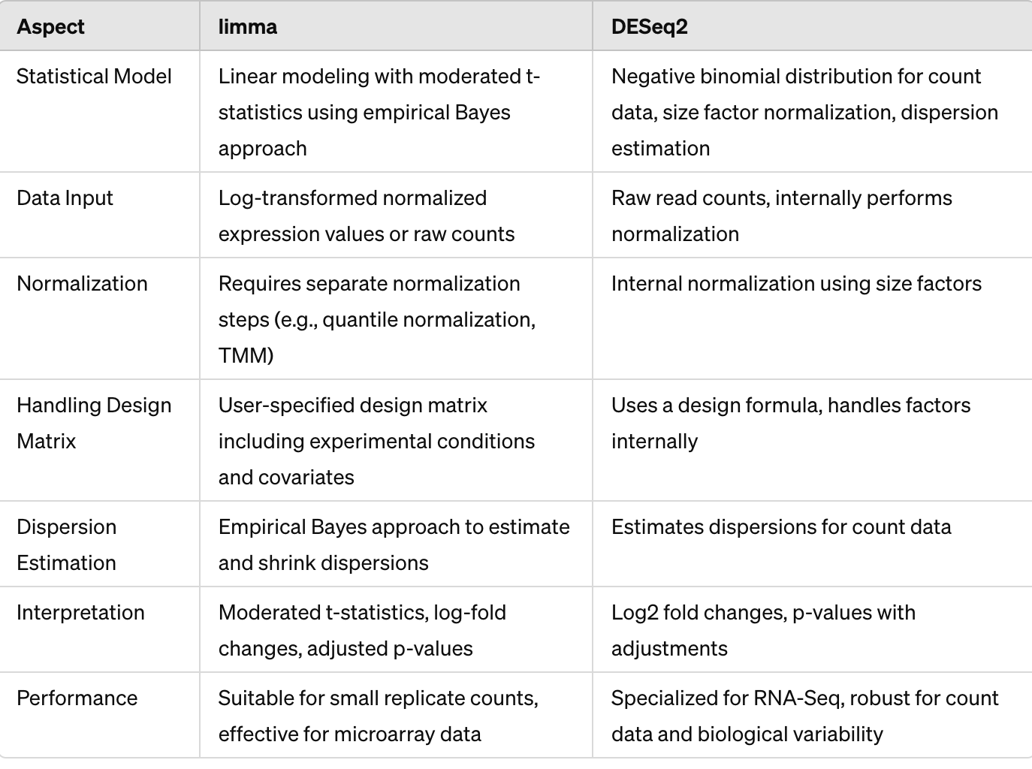
LIMMA VS DESeq2
Notes:
AM, DTB

